Slide 1

Azure Arc - Microsoft Ignite 2019
Sam Rueby
Senior ASP.NET Web Application Engineer
Bross Group
@SamRueby on Twitter

Slide 2
Cortana

Slide 3
Cortana

Slide 4
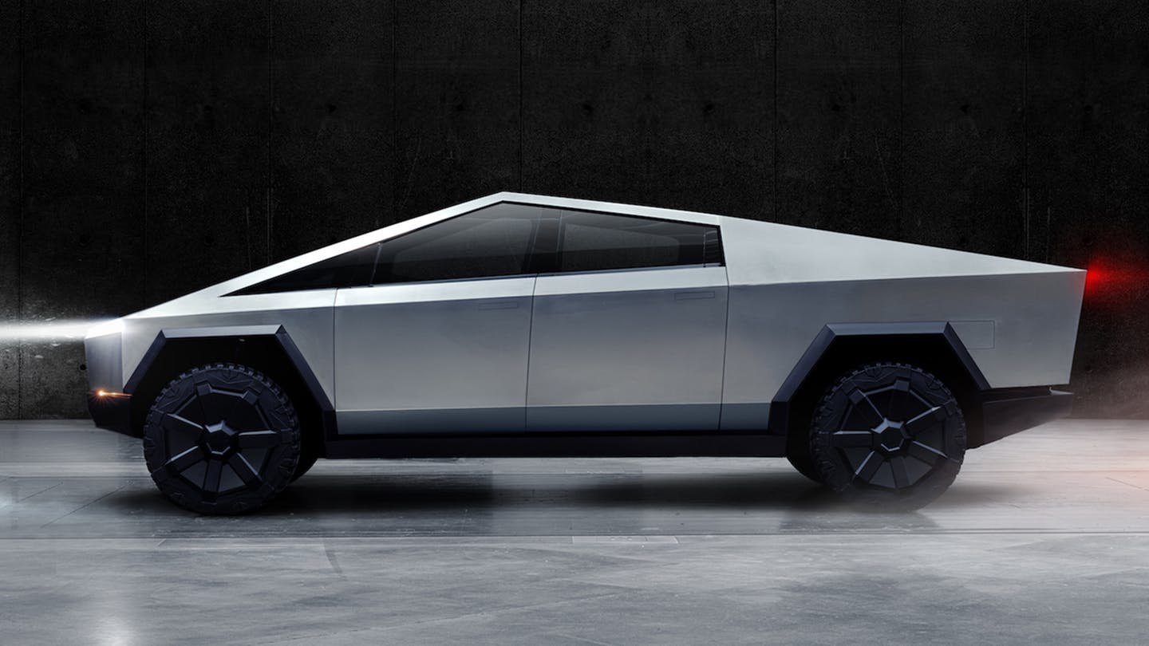
Musk – Tesla warthog

Slide 5
Musk – Tesla warthog

Slide 6

Azure Ark™
Notes:
President wants a Space Force
Microsoft wins $10b pentagon contract – coincidence?
Earth’s primary protection against the Covenant
Sorry, azure arc not azure ark

Slide 7
Azure Arc™?
Simplify environments across on-premises, edge and multicloud
Enables deployment of Azure services anywhere and extends Azure management to any infrastructure
Currently in Preview
No cost at this time
https://azure.microsoft.com/en-us/services/azure-arc/
Notes:
Sorry, azure arc not azure ark

Slide 8
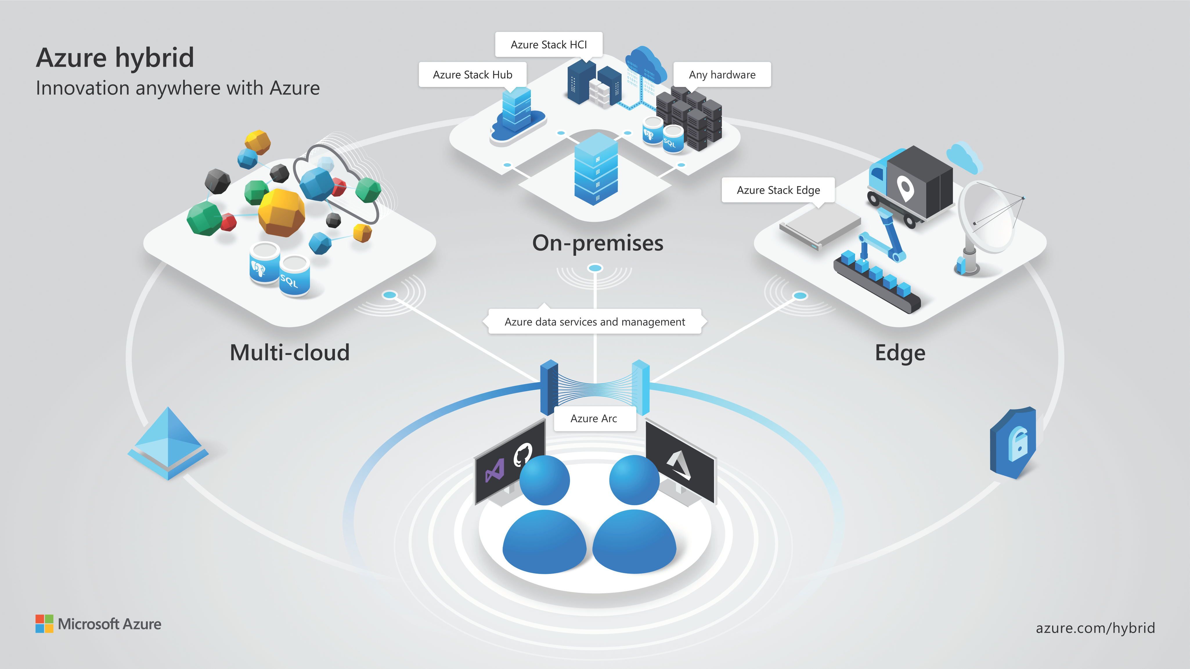

Slide 9
Organize and govern centrally, from a single place.
Deploy and manage Kubernetes applications across environments using DevOps techniques.
Get automated patching, upgrades, security and scale on-demand across on-premises, edge and multi-cloud environments for your data estate.
Notes:
Resources such as Windows and Linux Servers, Kubernetes clusters, and Azure services
Manage resources with powerful scripting, tools, Azure Portal and API, and Azure Lighthouse
Sig investment in on-prem can use this to dip toes into azure
Allows running azure-services and non, on-prem.
Cloud-practices on –prem (devops, self-service)
Azure-security, including Azure Thread Detection
Best scenario is companies that have workloads spread out everywhere.
Surprising amount of companies use multiple clouds.

Slide 10
Thank you

